Slide 1

Week 3

Slide 2
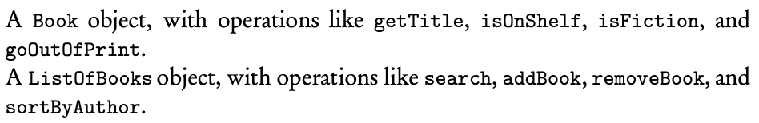
Revisit: Object
Every program that you write involves at least one thing that is being created or manipulated by the program, this thing, together with the operations that manipulate it, is called an object

Slide 3
Revisit: Classes
A software blueprint for implementing objects of a given type
An object is an instance of a class
Encapsulation: combining an object’s data and methods into a single unit

Slide 4
Keyword: public
Public classes are usable by all client programs
Public methods are accessible to all client programs

Slide 5
Keyword: private
Clients cannot access private instance variables or private methods of the class
Restriction of access is known as information hiding
Private methods and variables in a class can be accessed only by methods of that class

Slide 6
Keyword: static
A static variable contains a value that is shared by all instances of the class
Static means memory allocation happens once
Static final variables in a class cannot be changed

Slide 7
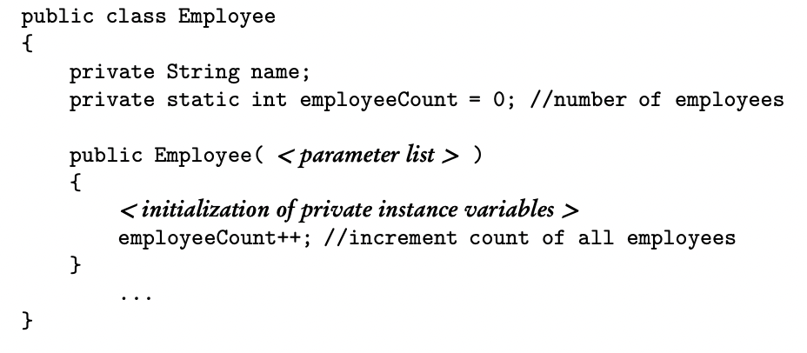
Employee employee1 = new Employee(); Employee employee2 = new Employee();

Slide 8
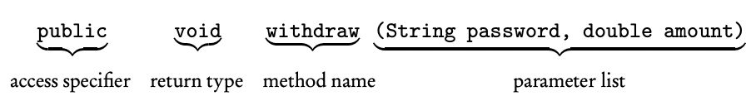
Method Headers
The access specifier/modifier tells other methods who can call this method
A return type of void signals no return value
Items in the parameter list are separated by commas

Slide 9
Constructors
Gets called when we create an object of the class
Name of the constructor is always the same as the class name
A constructor has no return type
Multiple constructors provide different ways of initializing class objects

Slide 10
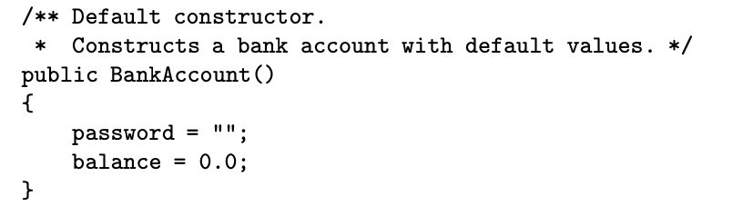
In a client method, the declaration is:

Slide 11
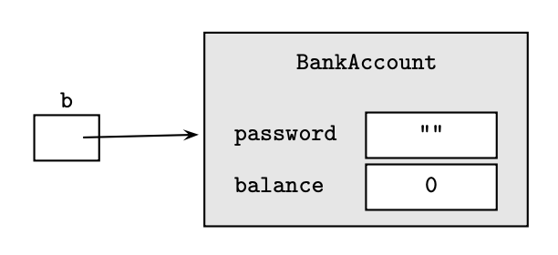
b is a reference to the object

Slide 12
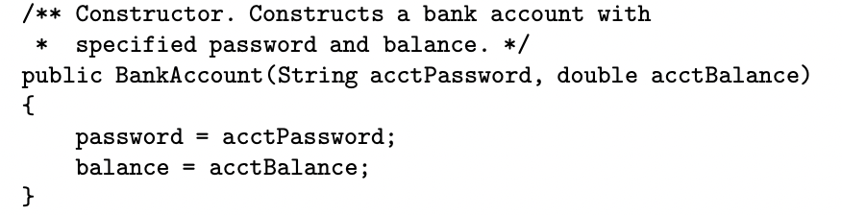
In a client method, the declaration is:

Slide 13
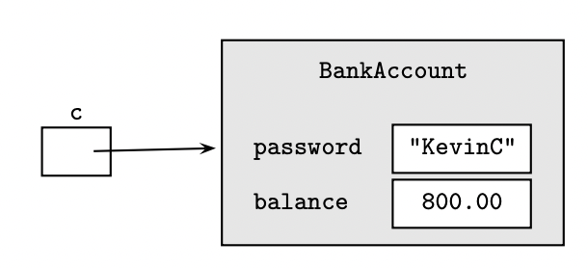

Slide 14
Accessors/Getters
An accessor method accesses a class object without altering the object
It returns some information about the object

Slide 15
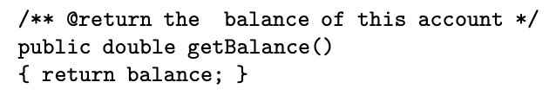
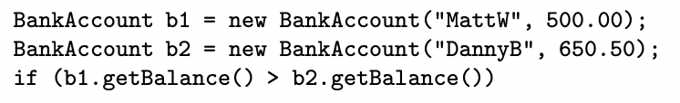
The . Operator indicates getBalance() is a method of the class to which b1 and b2 belong

Slide 16
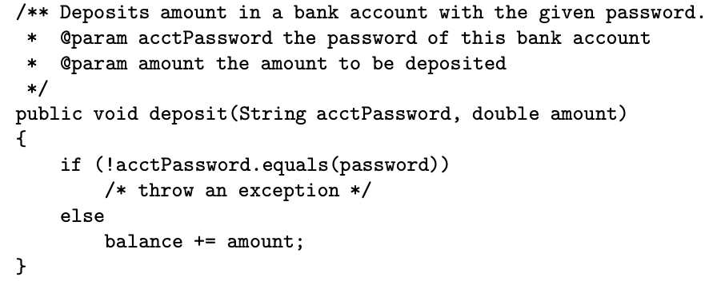
Mutators/Setters
Changes the state of an object by modifying at least one of its instance variables

Slide 17
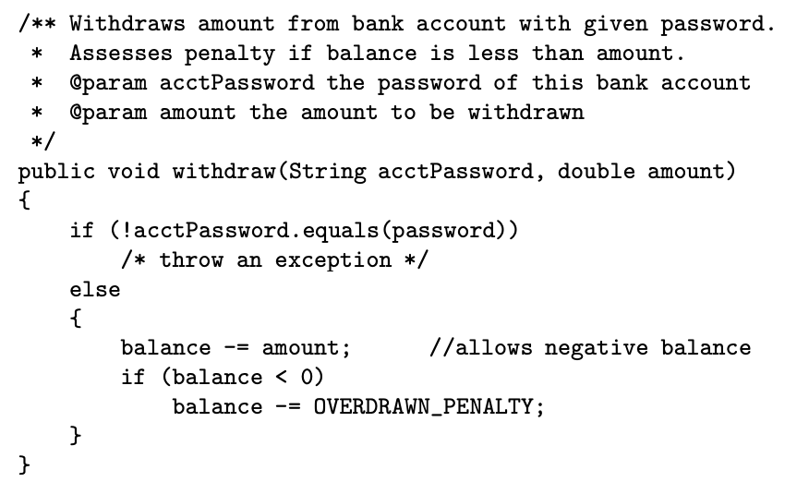


Slide 18
Static Methods
Constructors, accessors, and mutators are all instance methods
Instance methods operate on individual objects of a class
Static methods (class methods) perform operations for the entire class, not its individual objects
Static methods cannot use instance methods or instance variables, but static variables can be used

Slide 19

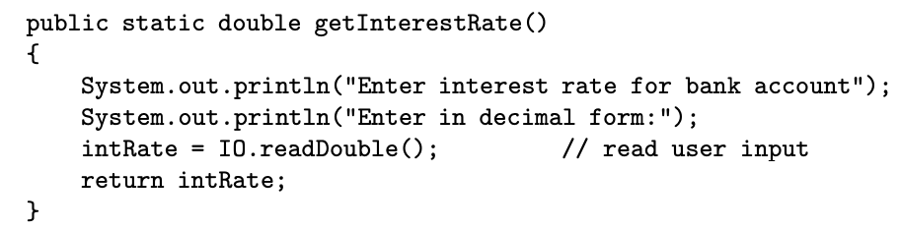

Slide 20
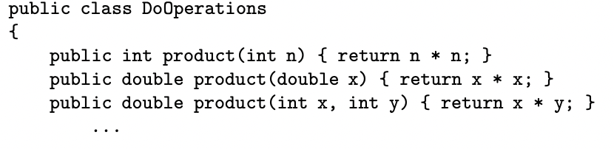
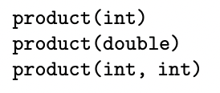
Method Overloading
Two or more methods in the same class with the same name but different parameter lists
Having multiple constructors is an example of overloading

Slide 21
Scope
The scope of a variable or method = the region in which that variable or method is visible and can be accessed
A local variable is defined inside a method, so the scope is only inside the method
Notes:
Homework: multiple choice 7, 11, 16, 22, 26

Slide 22
Keyword: this
All instance variables can be written with the prefix this followed by the dot operator
this represents an object, which is an implicit parameter to any methods that is invoked using this

Slide 23
